Slide 1


What’s new in F# 5 & 6
Don Syme |> @dsymetweets

Slide 2
Agenda
One pandemic, two language versions
Changes in how we talk about F#
Walk through F# 5 and F# 6

Slide 3
An update on how we talk about F#

Slide 4
A marketing exercise we did
Don Syme, Phillip Carter, Niklas Gustafsson also Reed Copsey, Isaac Abraham and others
Target markets:
Python programmers hitting the limits w.r.t typing and performance
C# programmers wanting succinct, data-oriented programming without leaving the .NET ecosystem
Plus Scala, Julia, Go, Rust and everything else ☺

Slide 5
A marketing exercise
Methodology
Write down all the technical features/qualities of F#
Mark them for relevance to the target market
Choose the top three

Slide 6
A marketing exercise, for example:
Quality | Features | Python devs hitting limits | C# devs wanting low ceremony
Succinctness | Type inference Expression-oriented Tuples Active patterns …. | Table stakes✔️ | Appeals! ✔️✔️✔️
Robustness | Types No-nulls Functional abstraction … | Appeals! ✔️✔️✔️ | Table stakes ✔️
Performance | Typed code Generics without boxing …. | Appeals! ✔️✔️✔️ | Table stakes ✔️
Expressiveness | … | … | …
Interoperable | … | … | …

Slide 7
Chosen Themes
Succinct
Robust
Performant
Notes:
2 minutes

Slide 8
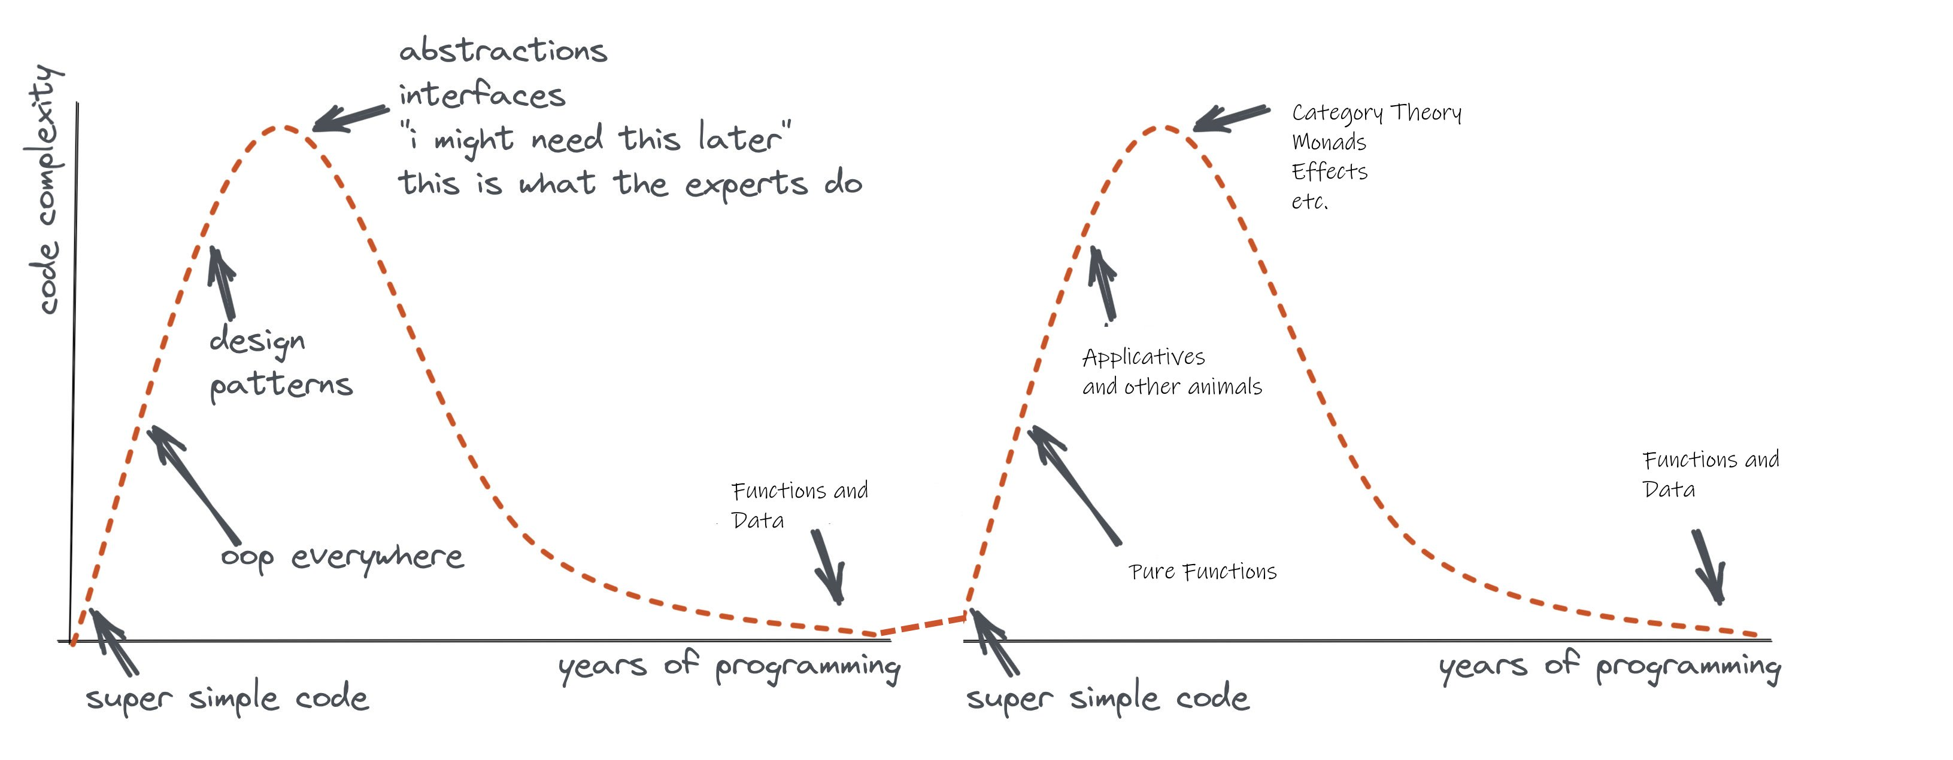
Remember the eternal sweet spot of programming! Functions + Data + Types

Slide 9
What is F# good at?
dot.net/fsharp

Slide 10
F# is good for programming
dot.net/fsharp

Slide 11
F# is good for web programming
dot.net/fsharp

Slide 12
F# is good for cloud programming
dot.net/fsharp

Slide 13
F# is good for AI/ML/data-science programming
dot.net/fsharp

Slide 14
F# is good for succinct programming
dot.net/fsharp

Slide 15
F# is good for correct programming
dot.net/fsharp

Slide 16
F# is good for performant programming
dot.net/fsharp

Slide 17
F# is good for programming
dot.net/fsharp

Slide 18

F# get started
dotnet new -lang F# dotnet build
F# tools are part of the .NET SDK, available everywhere
www.dot.net

Slide 19

F# for the web backend
dotnet new -i "giraffe-template::*" dotnet giraffe
High perf, functional server-side programming
A functional ASP.NET Core micro web framework for building rich web applications. github.com/giraffe-fsharp/Giraffe

Slide 20


F# for the web frontend (JavaScript)
dotnet new -i "Fable.Template::*" dotnet new fable npm install npm start
You can use F# as a JavaScript language
websharper.com
fable.io
Notes:
WebSharper also includes an excellent JavaScript compiler for F#

Slide 21


F# for the full stack with SAFE
dotnet new -i SAFE.Template dotnet new SAFE dotnet tool restore dotnet run
=
+
+
Notes:
NOTE: other excellent full-stack options exist, including “WebSharper”

Slide 22
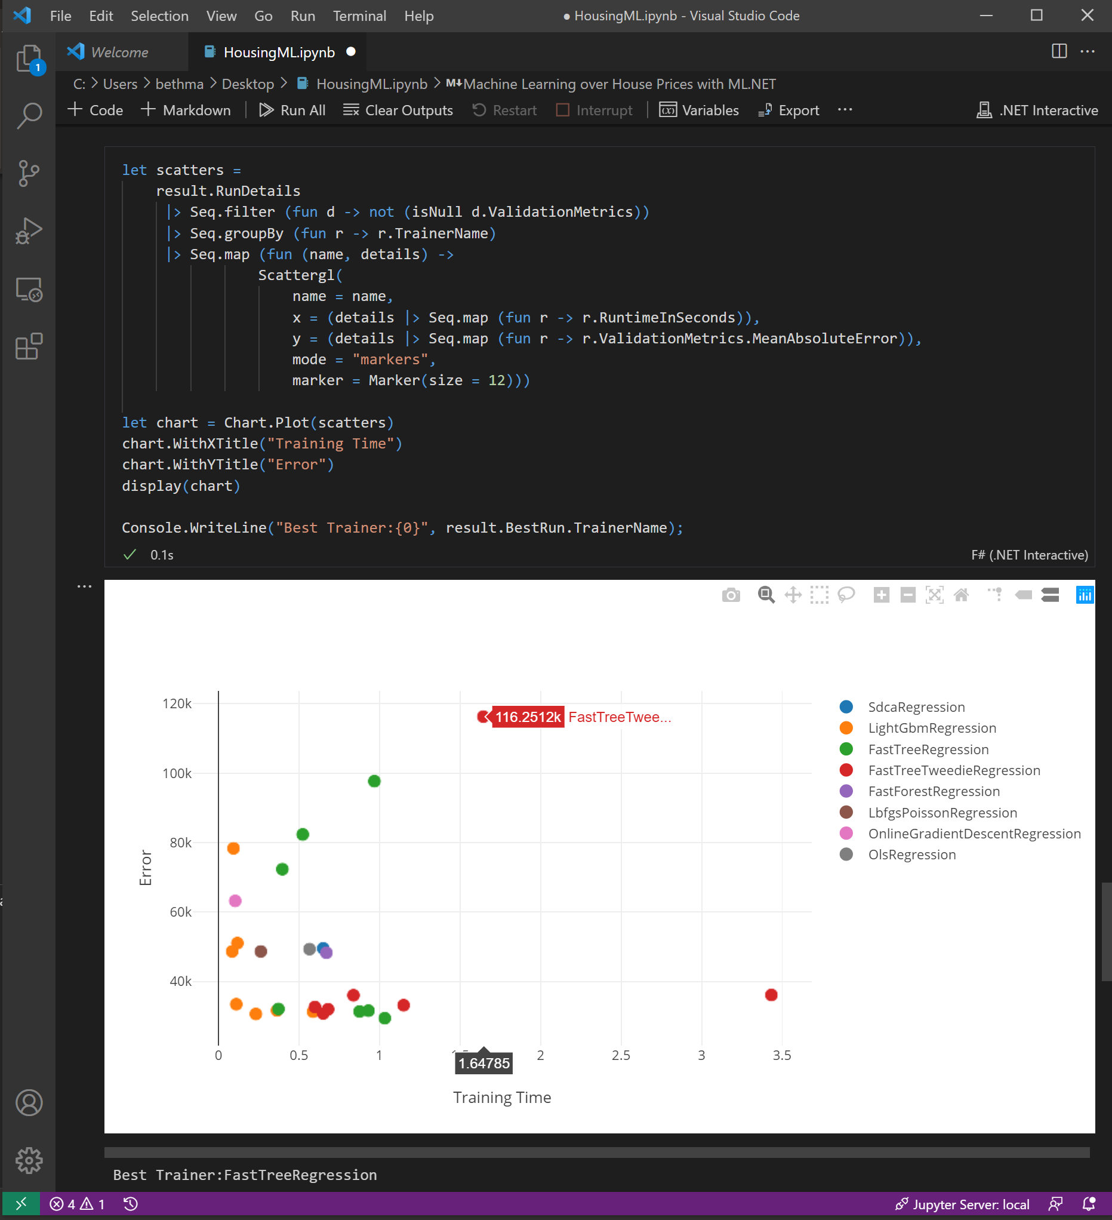
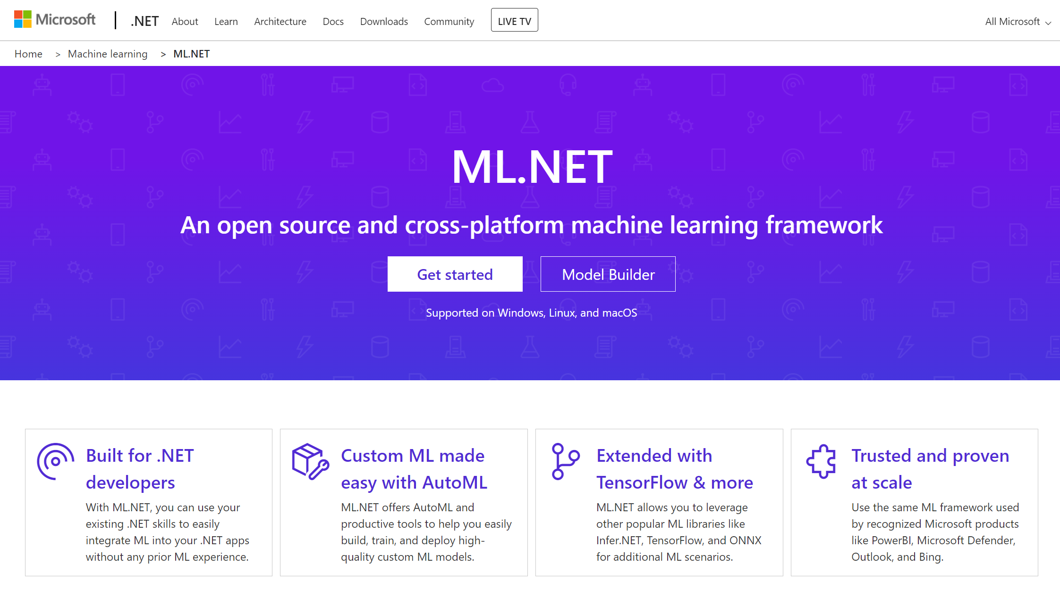
F# for data science & ML
#r "nuget:Microsoft.ML,1.4.0"
#r "nuget:Microsoft.ML.AutoML,0.16.0"
github.com/dotnet/interactive
dot.net/ml

Slide 23
F# 5! Release Nov 2020

Slide 24
F# 5 - Laundry list
FSharp.Core targets netstandard2.0
#r "nuget: …“
.NET Interactive
String interpolation!
nameof
“open type”
Slicing updates
let! .. and! ..
Stack traces for async
Multi generic instantiations
Default interface member consumption
Interop with nullable value types
Improved Map/Set performance
Improved Compiler performance
Checked XML docs

Slide 25
F# 6! Release Nov 2021

Slide 26
F# 6 - Laundry list
task { … }
Resumable code
expr[idx]
Structs for partial active pattern returns
Overloaded custom operations in CEs
“as” patterns
Indentation syntax revisions
InlineIfLambda
4x perf for list and array expressions
Additional implicit conversions
Immutable collection updates
More unit annotations
! and := soft deprecation
Remove legacy features
Pipeline debugging
Value shadowing
Tooling perf, scalability (64-bit, multi-thread)
.NET Core default for VS scripting
Scripting respects global.json
General improvements in .NET 6
General improvements in Visual Studio 2022

Slide 27
String interpolation
The very first F# RFC FS-1001, from 2014
Improved readability
Reduced errors
More succinct
Less to learn
Design has been iterated, very happy with the result
Safer than any other language with string interpolation
Aim
Align with C#
But keep strong typing by unifying with printfn
Allow use with printfn + friends
Demo

Slide 28
“open type”
RFC FS-1068
Increase expressivity of F# DSLs and ultra-succinct mode programming
Single-word “functions” can be overloaded members accepting named, optional, ParamArray arguments
Demo
Caveat emptor. Don’t inflict this on yourself or your friends without real thought about ramifications

Slide 29
#r "nuget: …"
People rate this as the #1 feature for Python programmers
Combined with global.json in script directory allows you to “lock down” F# scripts as trustworthy
#r "nuget: Newtonsoft.Json“
#r "nuget: Newtonsoft.Json, 11.0.1"
#i "nuget: https://my-remote-package-source/index.json"

Slide 30
let! … and! ….
Extends F# computation expressions

Slide 31
Computational modalities in F# (computation expressions)
Iterator methods (from Icon)
Query expressions
modality { code }
Comprehensions
Async
2007 – monads, monoids, async, comprehensions
2012 – queries, extended comprehensions
Async sequences

Slide 32
Computational modalities in C#, F# (computation expressions)
C# Iterator methods
seq { code + yield }
C# Query expressions
query { code + yield + custom }
C# Collection initialization
[ code + yield ]
C# Async methods
async { code + let! }
C# Async iterator methods
asyncSeq { code + let! + yield }
coroutine { code + yield() }

Slide 33
Monadic binding (let!)
let!
let!
let!
return
magic
magic
magic

Slide 34
Applicative binding (and!)
let!
magic
magic
and!
return
magic
and!

Slide 35
let! … and! ….
RFC FS-1063
Directly from the last F# London meetup before pandemic ☺
“let! … and! …” in computations
Maps to overloaded BindReturn/MergeSources
See RFC
Used for applicatives - two-phased computations
Separate “compose” from “run”
Static “composition”, then dynamic “run”
Example: graphs of fixed size (pre-allocate buffers, then run)
Example: validation (compose validators, then run)
Demo

Slide 36
expr[idx]
RFC FS-1110
Why?
We lose people for no reason
“Making F# better by moving it towards it already was”
Demo
Caveats

Slide 37
task { .. }
Why, what
Demo
Differences with async
A task is a single mutable, awaitable register
Hot start
No implicit cancellation checks
No implicit cancellation propagation
No tailcalls
Use primarily for interop when heavily consuming or producing tasks
Debugging can be better
Builds on “resumable code”, has other applications

Slide 38
!, :=, incr, decr soft deprecation
RFC FS-1111
These operators are highly confusing to beginners
They are now rarely used
Soft deprecation via informational messages
Demo

Slide 39
Performance and Scalability
F# Compiler Service new multi-threaded (no reactor queue!)
Makes IDEs MUCH more responsive
Visual Studio 2022 now 64-bit
Other major performance improvements, see announcements

Slide 40
Pipeline Debugging!
Demo
Also shadowing on values shown in debugging

Slide 41
Performance for [ .. ] and [| … |]
Demo/link

Slide 42
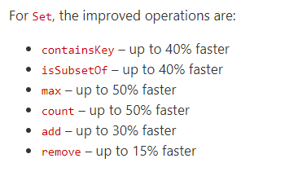
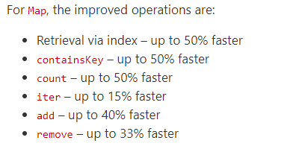
Improved Map/Set performance
By Victor Baybekov
In FSharp.Core 5.0.0+

Slide 43
Doc improvements
XML Doc checking!
FSharp.Core examples! (500)
docs.microsoft.com/dotnet/fsharp/ revamp!
Call to action. Stackoverflow is becoming a problem for us. Please update your answers!

Slide 44
Huge thank you to contributors
https://devblogs.microsoft.com/dotnet/whats-new-in-fsharp-6/#thanks-and-acknowledgments

Slide 45

Thanks!

